Slide 1
Capstone project

Slide 2

Online Flight Reservation System
Execution Flow and Functional Overview
This Photo by Unknown Author is licensed under CC BY-SA
Vishnu & Partner 09/11/2024

Slide 3
Table of Contents
Introduction
System Architecture
Execution Steps
Booking Processes
Method 1: Register & Book
Method 2: Direct Search & Book
Security Measures
Database Structure
Live Demonstration
Conclusion
Q&A

Slide 4
Introduction
Objective
Content
An overview of the Online Flight Reservation system.
We can book tickets in two ways
1. Register the user(details will be stored into dbo.Users table) Note: {We're encrypting User Passwords using HashEncryption for security policy}.
-> Login the user(details will be authenticated from db using jsonwebtokens(jwt))
-> search flights and book(available flight details can be created/found in dbo.Flights table)
-> Enter Passenger details(check cmd for booking ID and bookingID will be stored in dbo.Bookings table after successful booking)
-> Enter card details and make payment(). Note: {We're not storing raw card details for security policy}
->After successful Payment.(Payment details will be stored in "select * from Payments")
2. Click on search flight in home-> search flights and book -> Enter Passenger details -> Enter card details and make payment.
Note: User needs to login in above 2 approaches.

Slide 5
System Architecture
Technologies Used
Frontend: HTML, CSS, JavaScript (VSCode with Live Server).
Backend: Node.js with Express.js.
Database: Microsoft SQL Server (MSSQL).
Authentication: JSON Web Tokens (JWT).

Slide 6
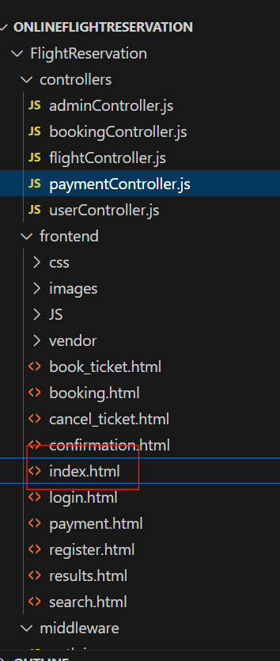
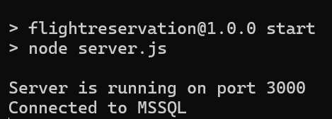
Execution Steps
Setup Backend:
Setup Frontend:
Navigate to OnlineFlightReservation/FlightReservation folder.
Open flight.cmd file.
Run the following commands in Command Prompt:
npm install
npm install mssql dotenv
npm install express dotenv cors bcrypt mssql jsonwebtoken
npm start
Outcome: Backend server starts on port 3000 and connects to MSSQL
Open index.html in VSCode.
Right-click and select Open with Live Server.

Slide 7
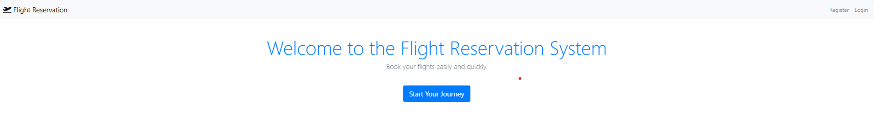
Frontend Overview
Landing Page

Slide 8
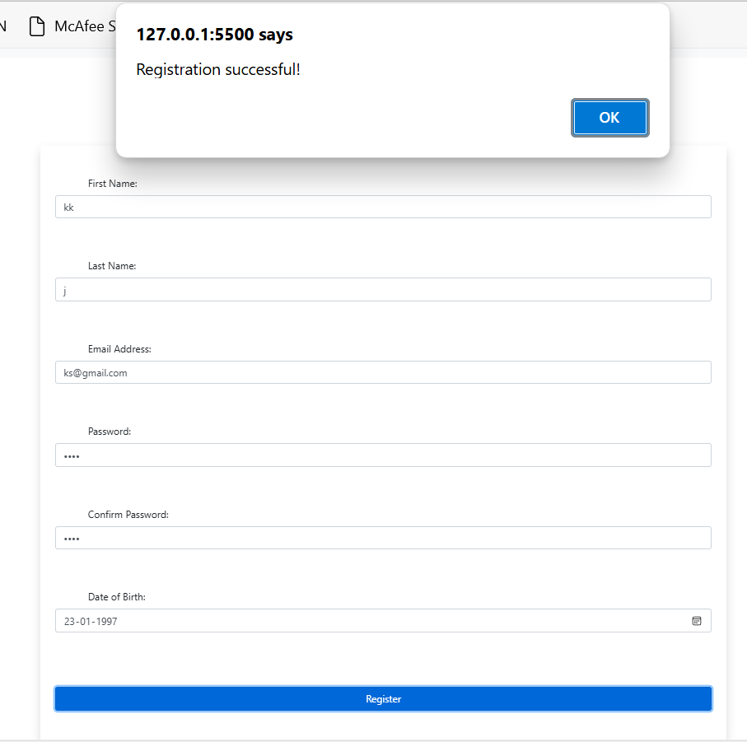
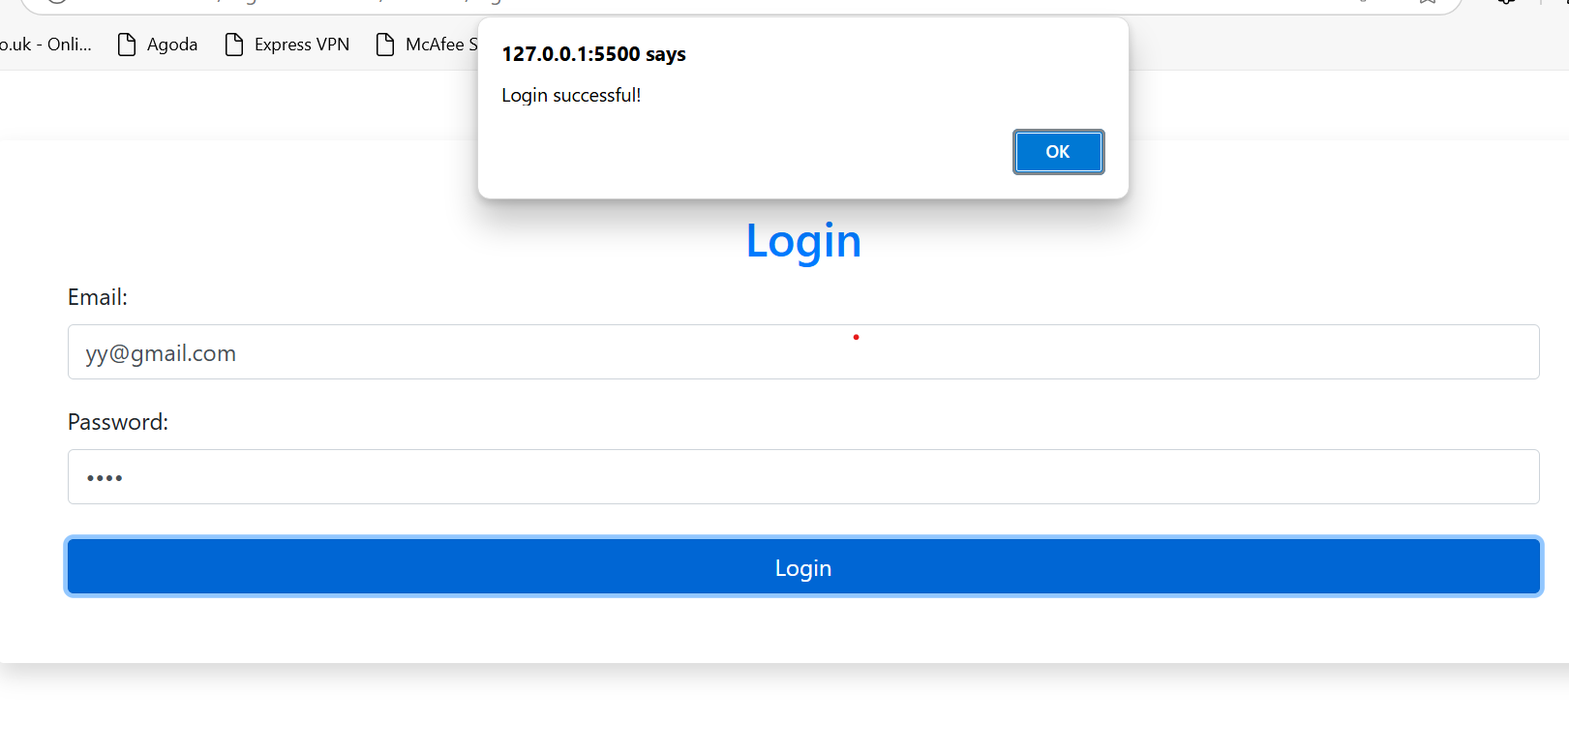
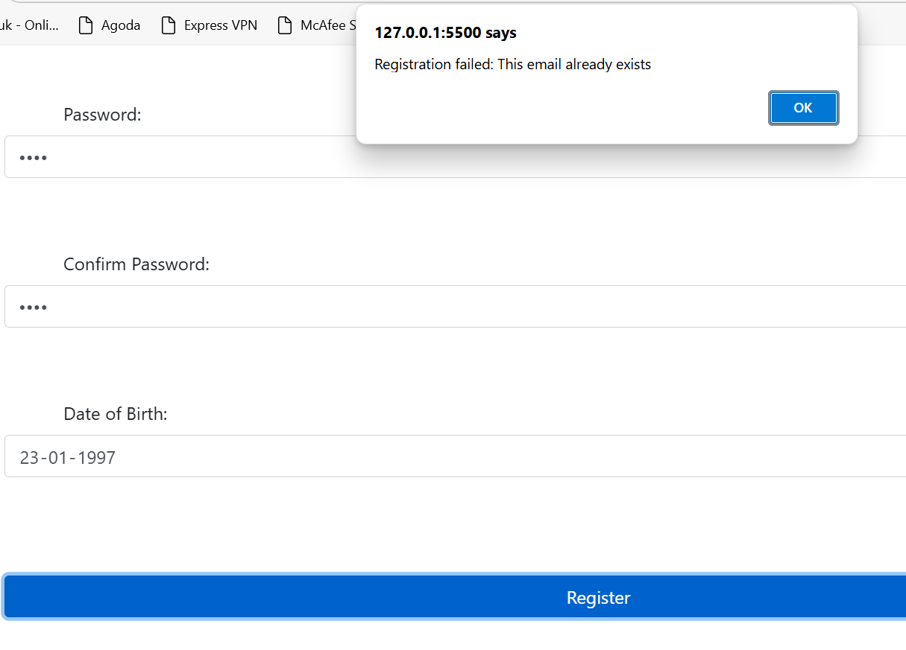
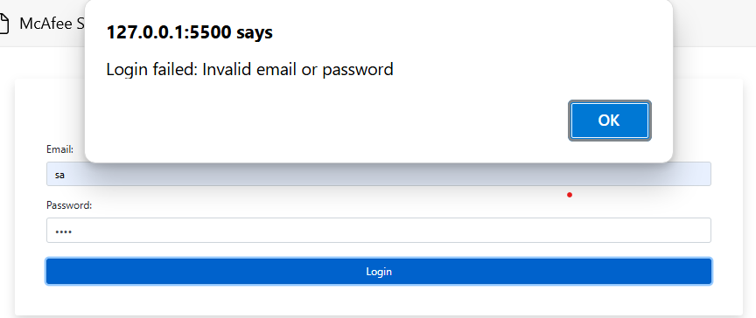
Frontend Overview
HomePage: Registration and Login interfaces.

Slide 9
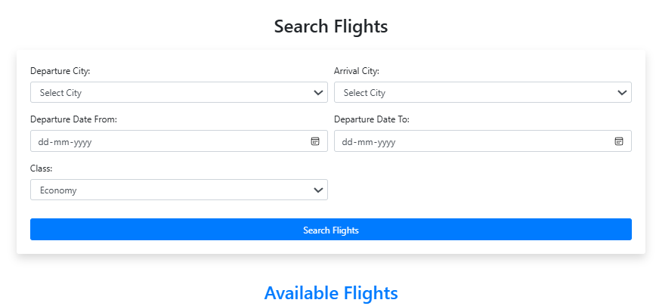
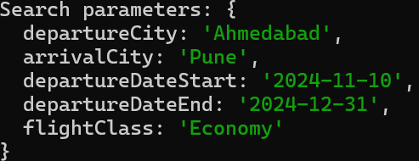
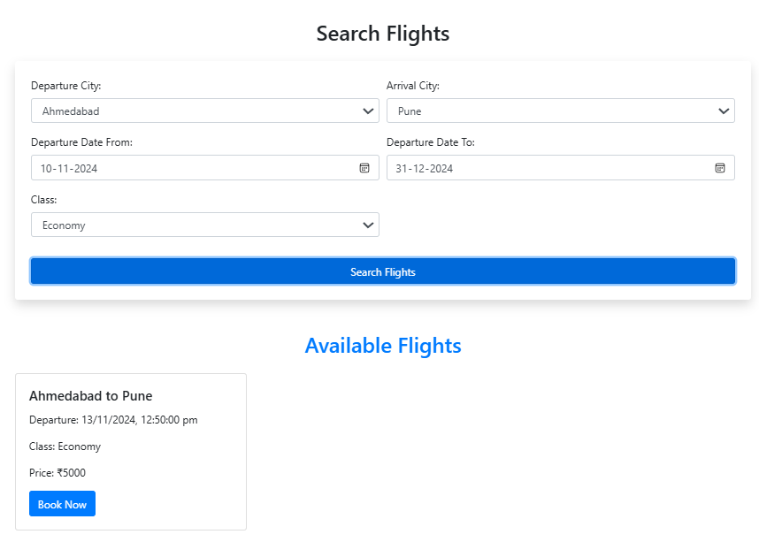
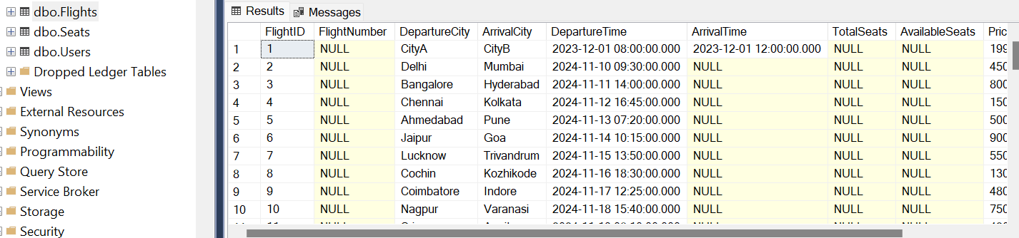
Frontend Overview
Flight Search: Interface to search and display available flights.

Slide 10
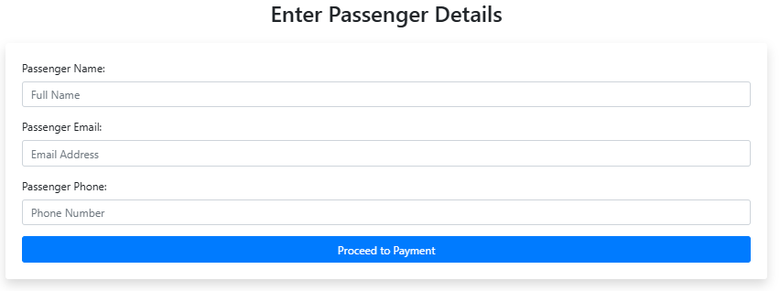
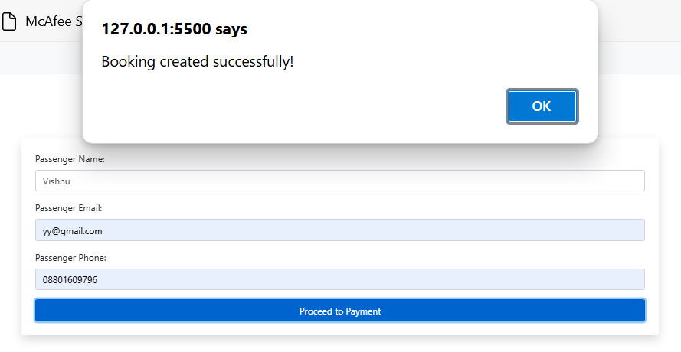
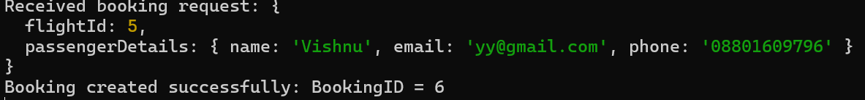
Frontend Overview
Booking Page: Form to enter passenger details.

Slide 11
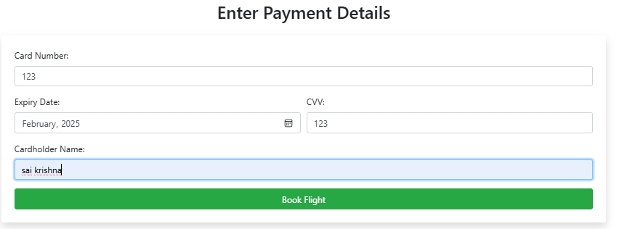
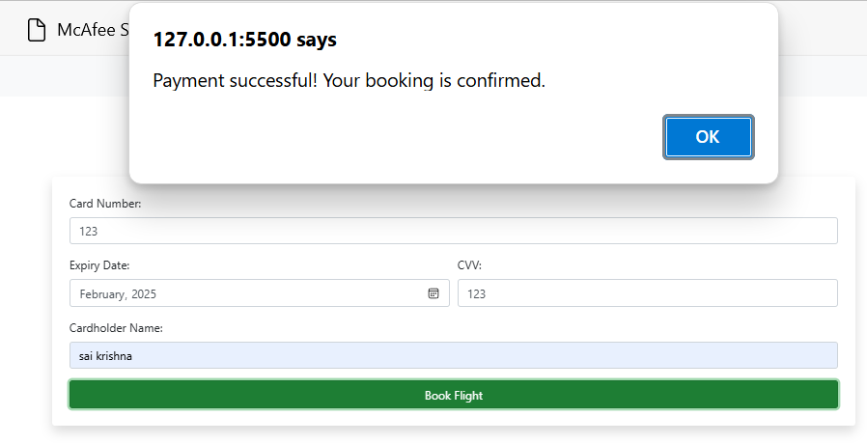
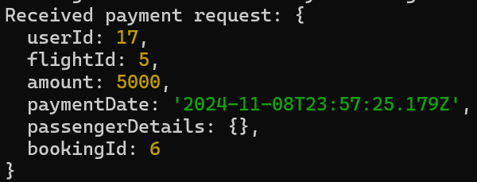
Frontend Overview
Payment Page: Form to enter payment details.

Slide 12
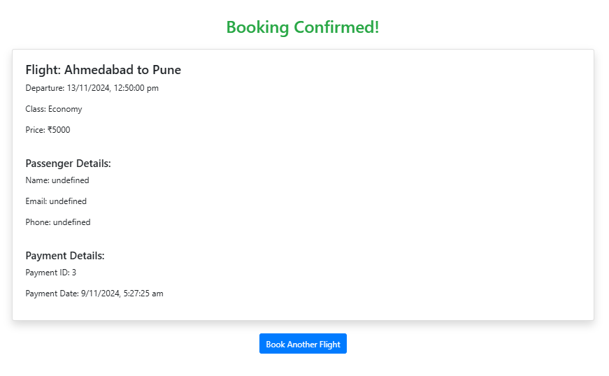
Frontend Overview
Confirmation Page: Booking confirmation details.

Slide 13
Security Measures
Content:
Password Encryption: Using bcrypt for hashing passwords before storing in dbo.Users
Authentication: Utilizing JWT for secure user authentication.
Payment Security: Not storing raw card details to comply with security policies.
Data Validation: Ensuring all inputs are validated to prevent SQL injection and other attacks.

Slide 14
Database Structure
Content
Relationships
Tables Involved:
Users: Stores User Information
Flights: Contains flight details.
Bookings: Links users to flights with passenger details.
Payments: Records payment transactions.
Users<>Bookings(One to Many)
Flights<> Bookings(One to Many)
Bookings<>Payments(One to One)

Slide 15
Live Demonstration
Register a New User
Show registration form and successful registration.
Login
Demonstrate login process and token storage.
Search for Flights
Enter search parameters and display results.
Book a Flight
Select flight, enter passenger details, and submit booking.
Show Command Prompt logs for booking creation.
Make Payment
Enter payment details and process payment.
Show Command Prompt logs for payment processing.
Confirmation
Display booking confirmation.

Slide 16
Handling Errors
Registration Errors: Email already exists.
Login Errors: Invalid credentials.
Booking Errors: Invalid token if user not authenticated.
Payment Errors: Missing or invalid payment details.
User Validation: User must be logged in to perform bookings.

Slide 17
Confirmation Flow
After Successful Payment:
Display confirmation message.
Option to make another booking until logged out.
Data Flow:
Booking details linked with payment in the database.

Slide 18
Conclusion
Summary:
Comprehensive flight reservation system with secure user authentication and payment processing.
Efficient data storage and retrieval using MSSQL.
Benefits:
User-friendly interface.
Robust security measures.
Scalable architecture.

Slide 19
Q&A

Slide 20
Thank you

